Slide 1

Minor project
S
mart
G
D
as-leak
etect
P
Presented by
Sravan A L Adithyan S
ro

Slide 2
introduction
Smart Gas-leak Detect Pro is an intelligent gas leak detection system designed for safety and hazard prevention. It continuously monitors gas levels and shuts off the valve when the threshold is exceeded.The valve remains locked until manually reset, ensuring controlled intervention. Real-time data is logged to Firestore for monitoring and analysis. With WiFi connectivity, cloud-based storage, and a servo-controlled safety mechanism, Smart Gas-leak Detect provides a reliable and efficient gas detection solution.

Slide 3
Key features
Real-time Monitoring
Automatic Safety Mechanism
Manual Reset
Continuously measures gas levels using an MQ-5 sensor.
The additional safety valve closes immediately in case of gas leaks that cross levels that are considered safe.
Once the safety valve closes. It is made sure to not accidentally open, it has to be manually reset to allow further gas flow once issue is resolved.
Cloud Storage & Alerts
WiFi Connectivity
Sends real-time gas level data to Firestore for monitoring
Enables remote data logging and future expansion.

Slide 4
motivation
Prevent Gas Leak Accidents
Gas leaks can cause fires, explosions, and health hazards. A reliable detection system enhances safety.
Lack of Automated Safety Systems
Many gas detection systems only alert users but do not take immediate action. Our system automatically shuts the valve to prevent danger.
Manual Reset for Controlled Safety
Unlike dynamic systems, our model ensures human intervention before reactivating the gas supply.
Scalability for Smart Homes
With IoT and cloud integration, this system can be expanded for remote monitoring and control.

Slide 5

Technology used
ESP32
Microcontroller for WiFi connectivity and control.
MQ-5 Gas Sensor
Detects combustible gases in the environment.
Servo Motor
Acts as a safety gas valve control mechanism.
Google Firestore
Stores and tracks gas level readings.

Slide 6

Working Process
G
Gas Detection – The sensor continuously reads gas levels.
Threshold Check – If gas levels exceed the safety limit, the system activates.
Valve Closure – The servo motor locks the gas valve to prevent leakage.
Data Logging – Readings are stored in Firestore for analysis.
Manual Reset Required – The system requires a physical reset after an alert.

Slide 7
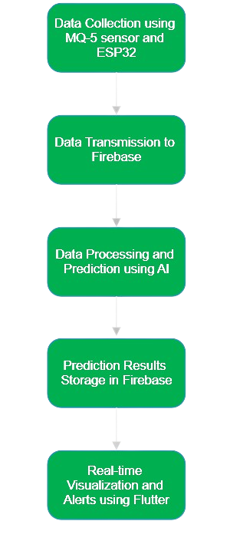
D
Methodology

Slide 8
Advantages
Enhances safety by preventing gas-related accidents.
Provides real-time data for monitoring and analysis.
Ensures controlled intervention with manual reset.
Cloud storage allows historical tracking of gas levels

Slide 9



Future enhancement
Multi gas detection
Battery backup system
Smart home integration
Expand support for detecting types of hazaedous gases in Industry purpose
Ensure functionality during power outages for uninterrupted gases
Connect with IoT platform like Alexa or Google home for seamless automation

Slide 10
Summary
P
Smart Gas-leak Detect is an intelligent gas leak detection system designed for safety and hazard prevention.It automatically shuts off the gas valve when dangerous gas levels are detected. The valve remains locked until manually reset, ensuring controlled intervention. Real-time data is stored in Firestore, enabling cloud-based monitoring and analysis.Uses ESP32, MQ-5 sensor, and a servo motor to provide an efficient and scalable solution. Future enhancements include mobile app integration, AI-based leak prediction, and smart home compatibility

Slide 11


Thank you

